Slide 1
Hybrid Mobile App Development with Flutter
Speaker: Himanshu Sharma

Slide 2


GLA University
Mathura
JoVAC – Job Oriented Value Added Course
Hybrid Mobile App Development with Flutter
Submitted By:
Himanshu Sharma B.Tech CS AIML
201550062
Akshit Saxena B.Tech CS AIML
201550018
Submitted To:
Pankaj Kapoor Corporate Trainer
Molika Agarwal B.Tech CS AIML
201550083
Prateek Kumar B.Tech CS AIML
201550102
Rahul Pradhan Asst. Prof. (CEA)
Sangam Bansal B.Tech CS AIML
201550123
Mayank Saraswat B.Tech CS AIML
201550081
Speaker: Himanshu Sharma

Slide 3
1.
What is Flutter?
Flutter - एक SDK
Speaker: Mayank Saraswat

Slide 4
फ्लटर!
A SDK
Hybrid
Open-Source Framework
Backed by Google
Speaker: Mayank Saraswat

Slide 5
SDK
Framework
Why Uniformity?
?
Speaker: Mayank Saraswat

Slide 6
2.
Dart?
Dart - एक Programming Language
Speaker: Prateek Kumar

Slide 7
डार्ट!
Object Oriented Language
Single Threaded
Open-Source
Developed by Google
Speaker: Prateek Kumar

Slide 8
2.
Why Flutter?
आखिर यही क्यों?
Speaker: Akshit Saxena

Slide 9
Reasons!
One for All / All for One
Easy Learning Curve
Native Performance
Fast Development
Speaker: Akshit Saxena

Slide 10
WIDGETS के प्रकार
Stateless Widget
Stateful Widget
Static
Independent
Have no State
Example:
Text
Icon
Raised Button
Dynamic
Dependent on User Action
State Changes
Example:
Checkbox
Radio Button
Slider
Speaker: Prateek Kumar

Slide 11
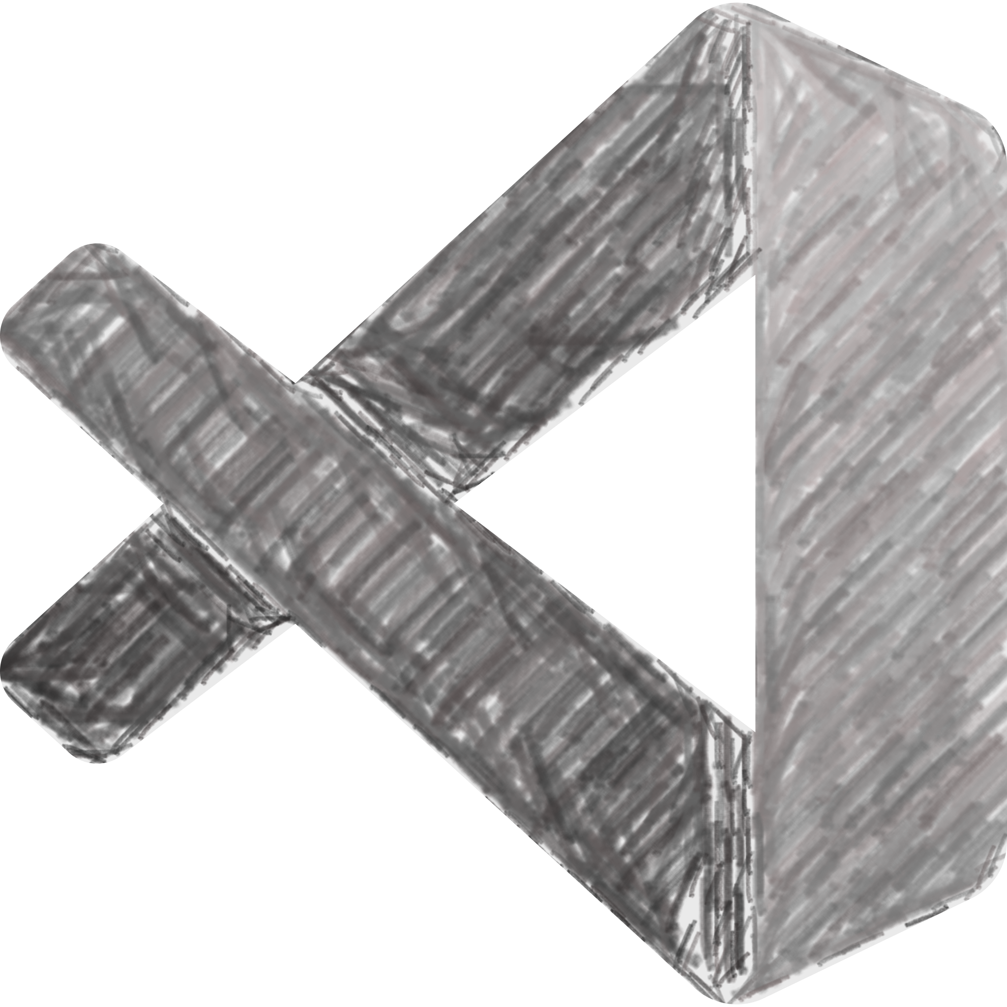
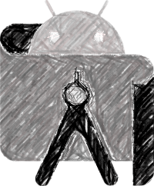
Code Editors For फ्लटर
Android Studio by Google
Android Studio is the official integrated development environment (IDE) for Android application development.
Microsoft VS Code
Visual Studio Code is a lightweight but powerful source code editor which runs on your desktop and is available for Windows, macOS and Linux.
Speaker: Akshit Saxena

Slide 12
Pubspec.yaml
Human Readable
Indentation Matters
Specifies Requirements
Speaker: Molika Agarwal

Slide 13
Problem Statement
We all know that, nowadays the craze of Anime, Web Series and all other OTT content is gradually increasing. And in our daily routine many of us don't have time to keep track of our ‘Watched’ and ‘Yet to Watch‘ content, because enormous amount of such content exists.
Solution:-
So here we are presenting our app "The Organizer - The Ultimate Entertainment Organizer”.
Which helps us to keep track of our desired content such as Anime, Movies and Web Series.
Speaker: Molika Agarwal

Slide 14
Our App is आसान
Add New
Update / Delete
Keep Tracking
Speaker: Molika Agarwal

Slide 15

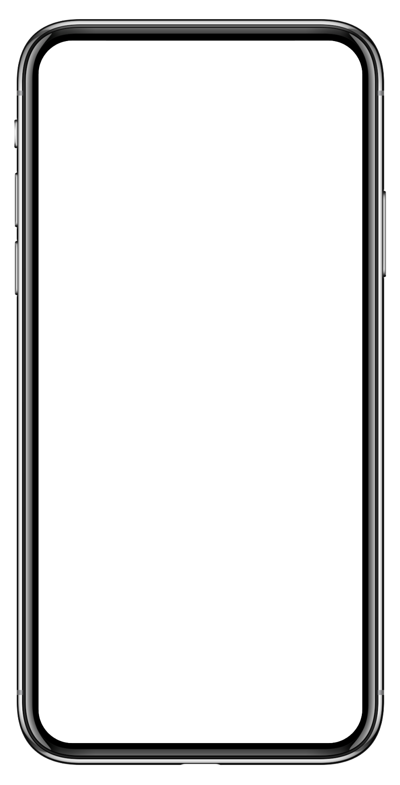
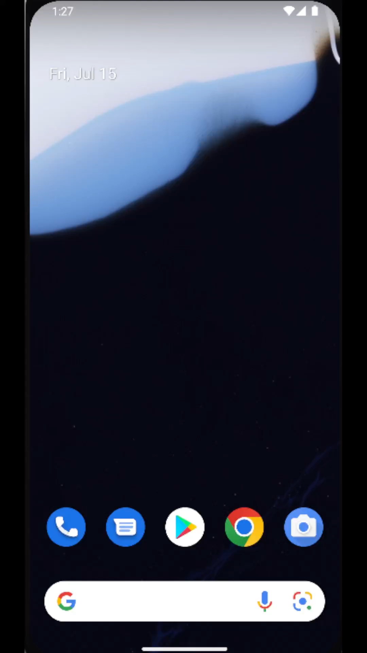
First Look Of the App ‘The Organizer’
Speaker: Molika Agarwal

Slide 16
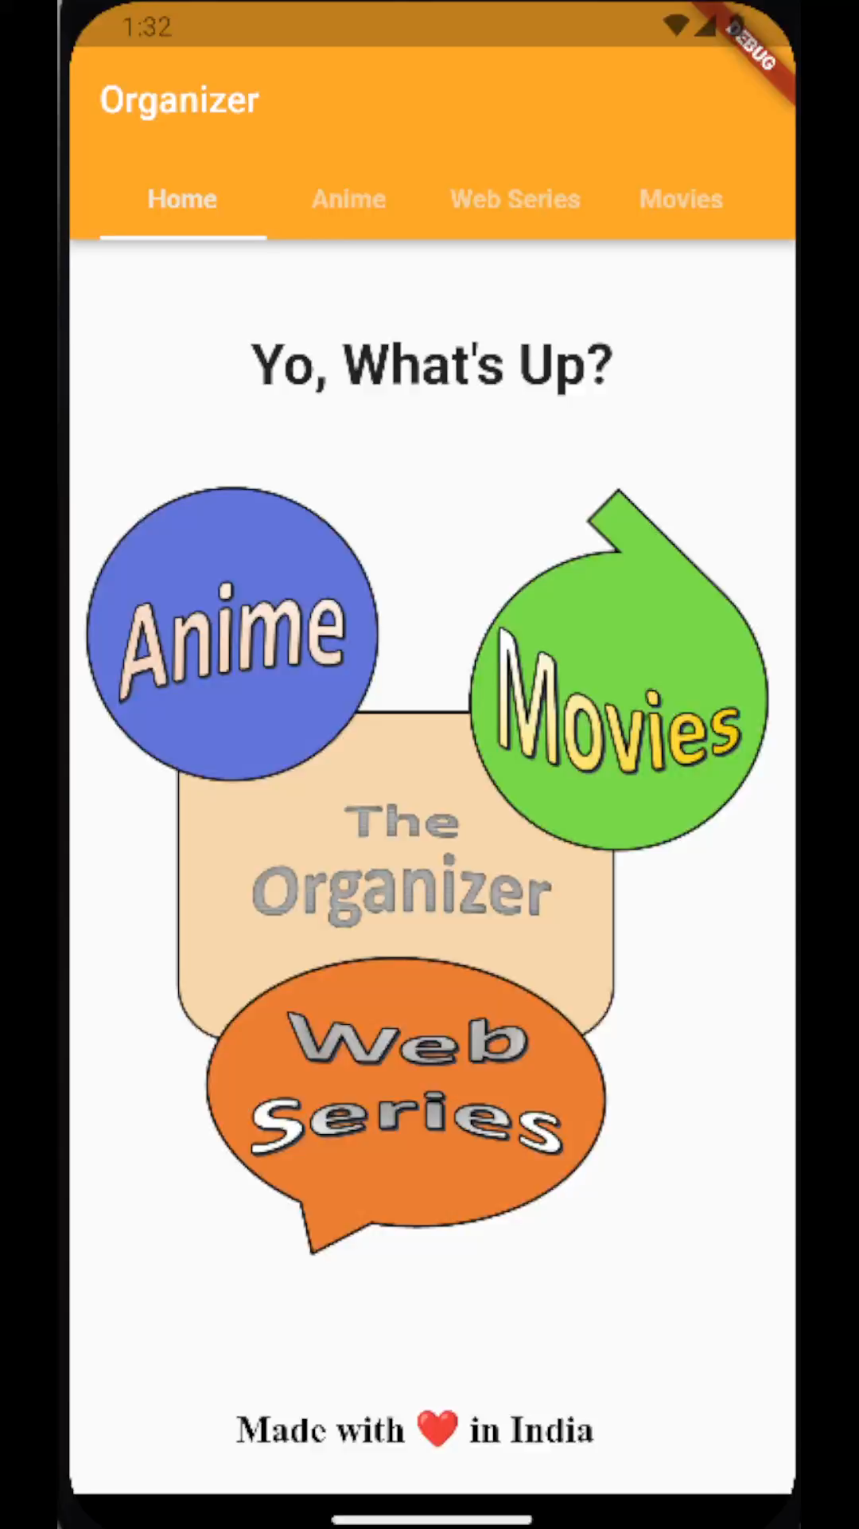
Navigating in Tabs by
‘clicking on Tab Labels’
Speaker: Sangam Bansal

Slide 17

Navigating in Tabs using
‘Image Buttons’
Speaker: Sangam Bansal

Slide 18
Navigating in Tabs by
’Scrolling’
Speaker: Sangam Bansal

Slide 19


Firebase
Firebase is a Backend-as-a-Service (BaaS) app development platform that provides hosted backend services such as a real-time database, cloud storage, authentication, crash reporting, machine learning, remote configuration, and hosting for your static files.
Speaker: Sangam Bansal

Slide 20

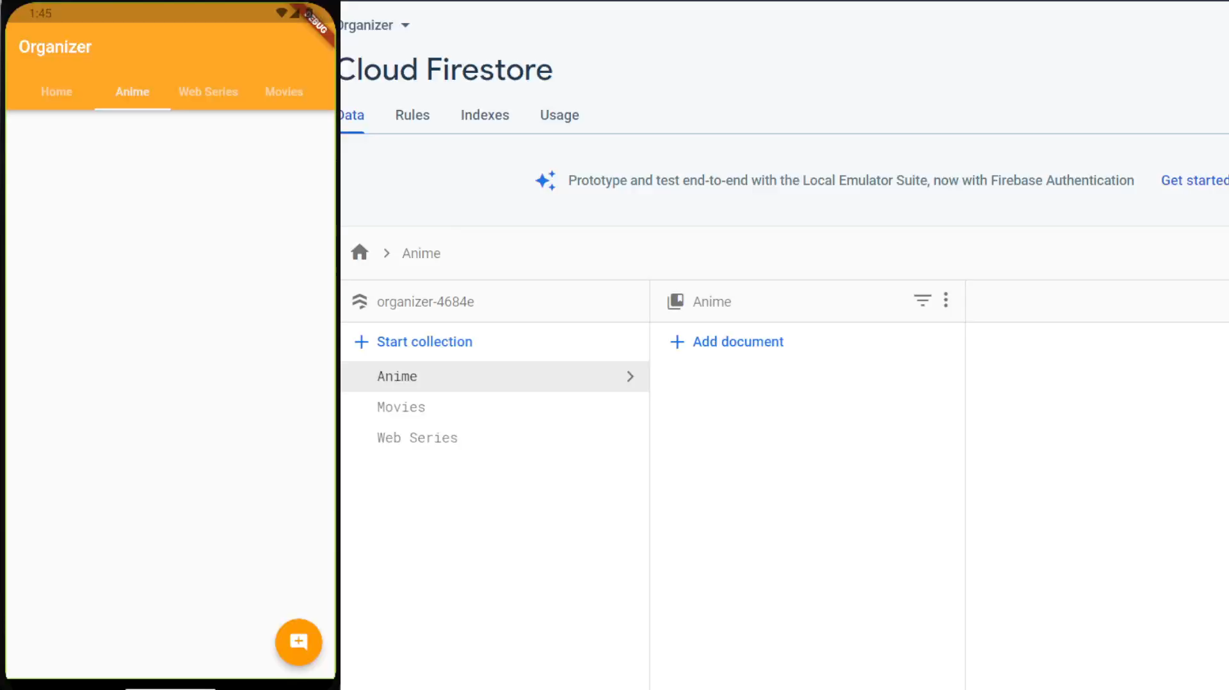
Adding data in our database through our app
Speaker: Himanshu Sharma

Slide 21
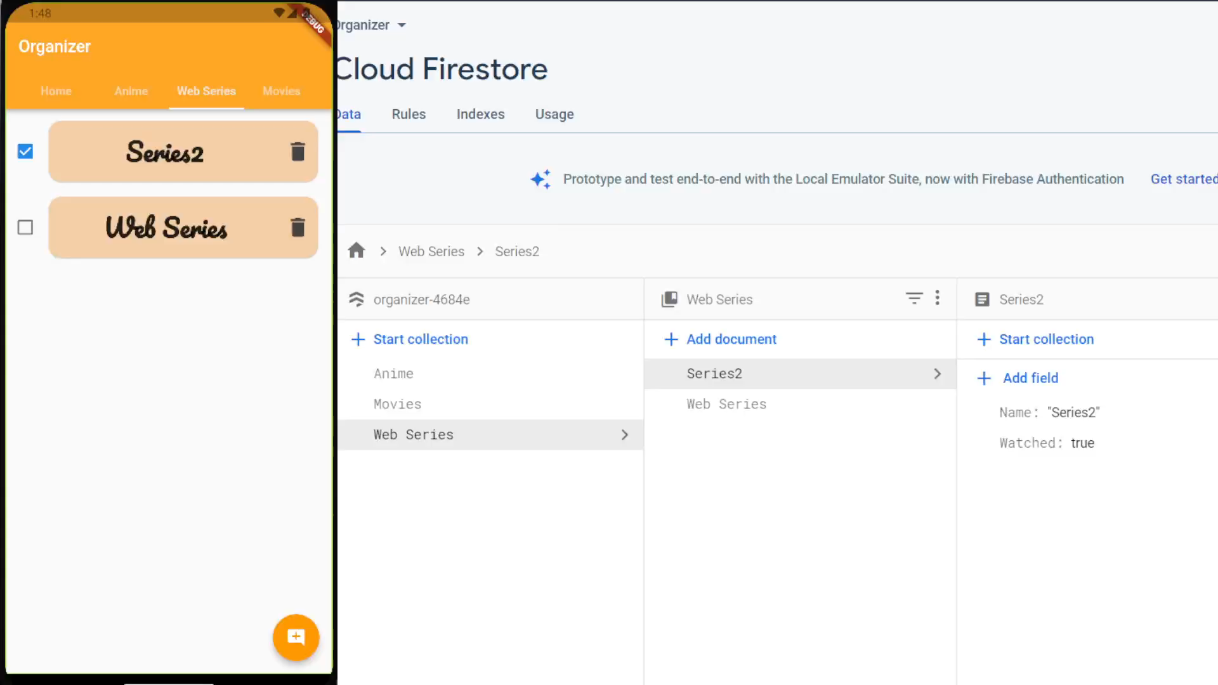
Updating data in our database through our app
Speaker: Himanshu Sharma

Slide 22
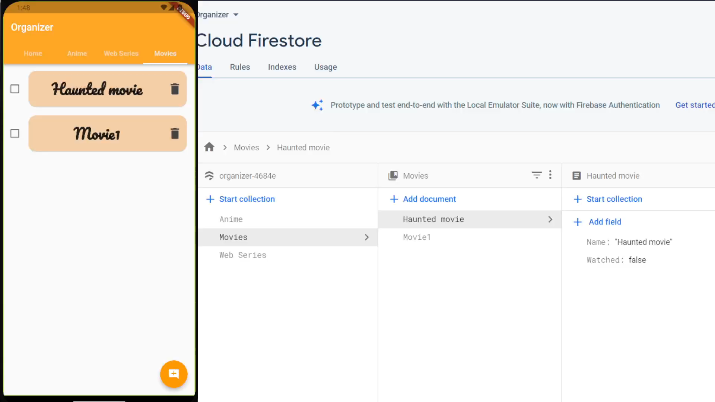
Deleting data in our database through our app
Speaker: Himanshu Sharma

Slide 23
Conclusion
Hence, we can create a fully functional and exciting Hybrid Mobile App using Flutter.
We can even customize the app according to our need and can use same code base for multi-platforms.
Speaker: Akshit Saxena

Slide 24
References
Notes By Pankaj Kapoor (Corporate Trainer),
SlideShare,
Google,
GeeksforGeeks,
Flutter Documentation,
StackOverflow.
Speaker: Himanshu Sharma

Slide 25
Thanks You!
Any questions?
Speaker: Himanshu Sharma

